Slide 1

<OnlineTrials> Managed the DevOps Way
Martin Whittington
Senior DevOps Engineer, Alfresco
Notes:
Hello everyone and welcome! Thank you for joining me at this fantastic event. My name is Martin Whittington and I am a Senior DevOps Engineer at Alfresco. This talk will cover Alfresco Online Trials and the part DevOps must play for their ongoing success.

Slide 2


Notes:
What are Online Trials? They are single user instances of Alfresco Content Services (now including Governance Services) which live in AWS for around 14 days that anybody can get by filling out a form on our main website.

Slide 3
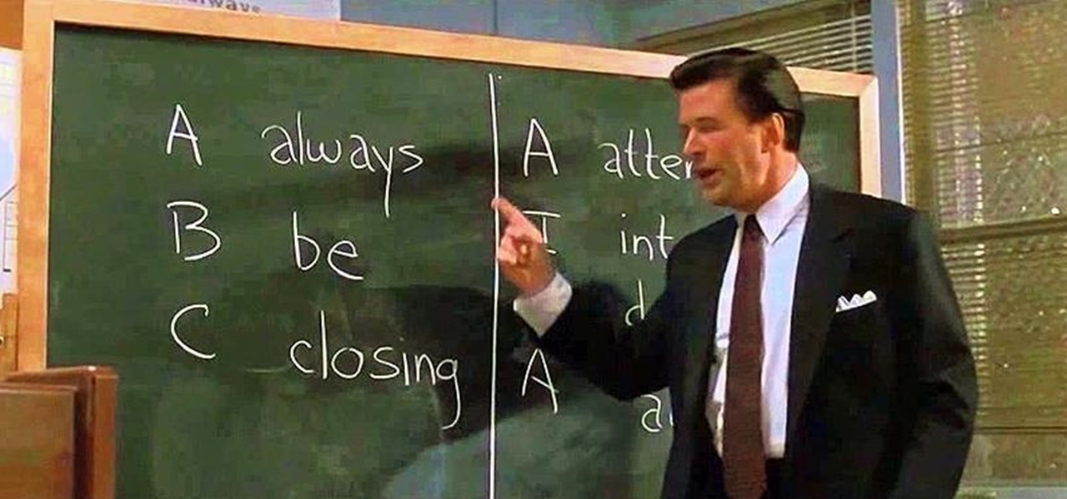
Notes:
Once the 14-day trial period has expired the requester is usually contacted by our sales departments to better understand how the experience was. Online Trials are an essential part of our business.

Slide 4

Notes:
Behind the scenes, we use a marketing tool called ‘Marketo’ that generates the lead once a request for a trial environment has been made. Marketo has a set of REST Api’s that we hook into as part of our deployment system.

Slide 5

Notes:
How did I get involved with Online Trials? It was another day at the office. I was working on another project and in the corner of my eye on my screen popped up a message stating that the trials infrastructure we have in place has some issues….again! A fix is needed urgently

Slide 6
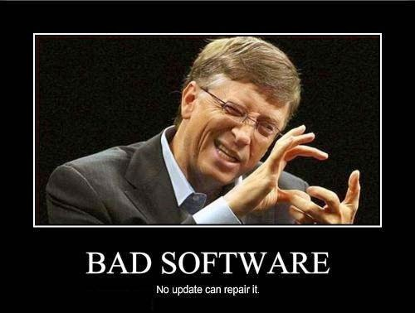
Notes:
What issues? The current system was just a prototype that at the time of development ticked some boxes, received some maintenance patches but needed major work to be reliable. But, as with most untested software, it was pushed out to production anyways.

Slide 7
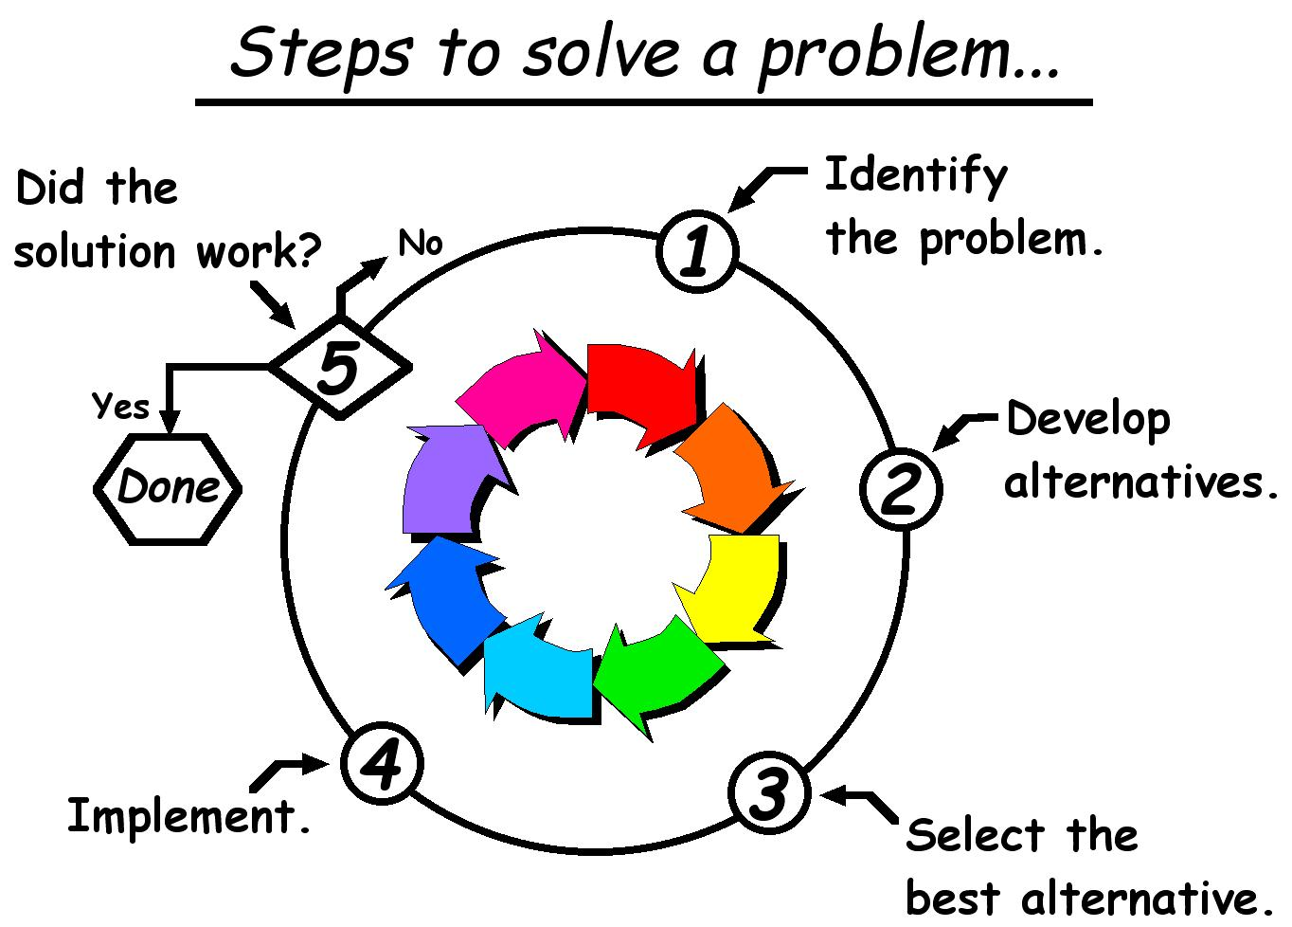
Notes:
My boss approached me and said, “We need to replace the current system we have, so can you please conceptualise an idea? This problem needs to be solved permanently as soon as possible”. The opportunity was simply too good to pass up.

Slide 8

Notes:
I reviewed what we have currently. A mix of two separate systems working together; one designed by IT, the other by DevOps. The DevOps system is a web portal that allows the creation of environments in AWS obfuscating the AWS console.

Slide 9

Notes:
The IT system is a collection of state machines, written in Python, that make decisions on how many instances to keep running, whom receives those instances and the notification to each of the customers that requested them. Any relevant data is stored in a database for further analysis.

Slide 10

Notes:
The most appropriate action to take next was to borrow the successes from the current systems, and there are some, then remove the pain points, of which there are plenty, and move closer to what we are trying to achieve; A seamless trial experience for our customers.

Slide 11
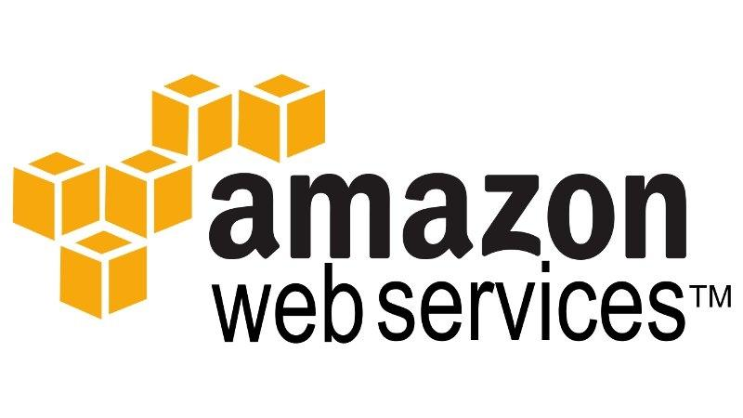
Notes:
Since the implementation of our deployment systems, AWS has released a plethora of functionality that has rendered our systems obsolete. Everything we need can be achieved wholly by the services and features they provide. It was time to go all in!

Slide 12






Notes:
I started looking at AWS and the resources that they offer. They have solutions such as CloudFormation, Lambda, SQS, SNS, DynamoDB and Opsworks. I did my research and realised these were the weapons of choice.

Slide 13

Notes:
I wanted this new system to be as hassle free as possible. No more manual management of servers, no more accidental shutdowns of instances, no more bespoke tools to abstract skill away from AWS. We need peace of mind.

Slide 14

Notes:
When I talk about hassle free, what do I mean? One constraint we have is that we are unable to patch hundreds of running instances in an automated way. With OpsWorks, we can patch any number of instances within minutes by running chef recipes we have written.

Slide 15

Notes:
I took some time to evaluate our current expenditure on the combined systems cost. With what we have running today, the monthly AWS bill is around $200. By switching to a server-less system, the cost will be between $5-10$ per month!!

Slide 16

Notes:
We use a pre-baked AMI that is deployed to all trial instances. The AMI is built and tested before being shipped. This delivers consistency to all our customers. With Chef and CloudFormation, we can guarantee that the configuration has worked as expected.

Slide 17
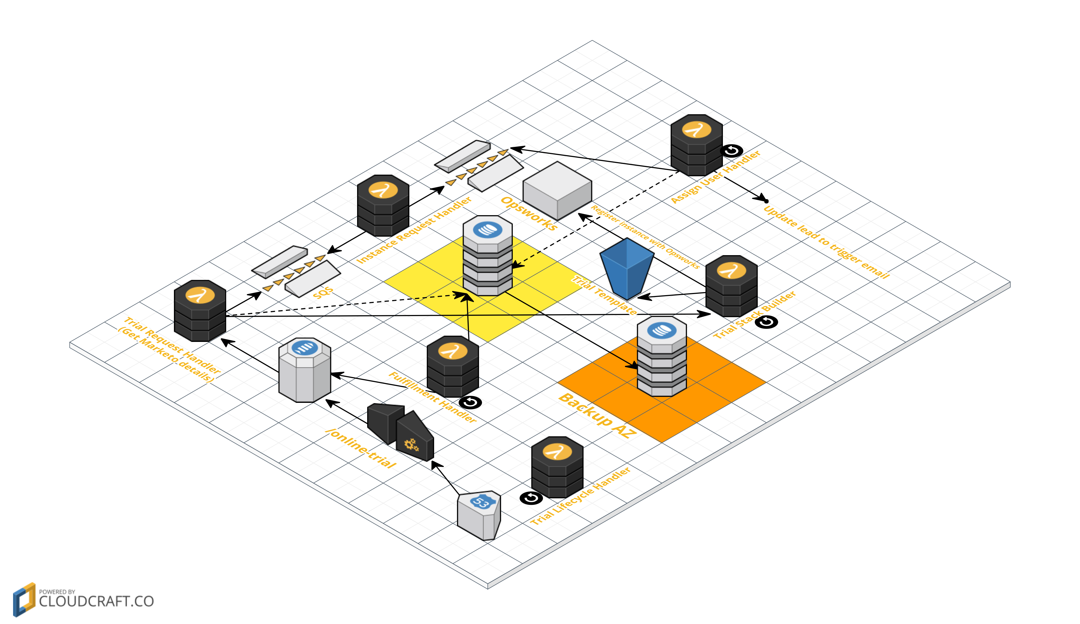
Notes:
How close are we to completion? We are currently in a testing phase. The infrastructure and code has been completed. Now we are putting the new system through its paces and fixing any bugs. We are in constant review of the infrastructure and technology choices as we iterate.

Slide 18
Notes:
How do we deliver this? We use Bamboo to action a pipeline that builds and deletes the control infrastructure. If successful, this then performs a rolling update to our live systems. We also build and test our Trial environment as part of this pipeline.

Slide 19
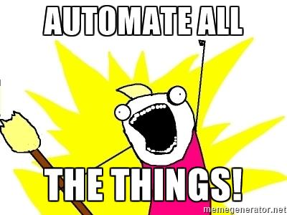
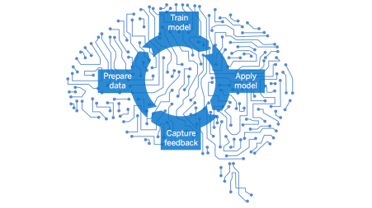
Notes:
What’s next? The theme of version 2 is centred on “Intelligence and Automation”. There are still a handful of manual steps that need automating. Conversely, the system should tell us if there’s any problems and what it thinks it should do to address them, learn and adapt.

Slide 20
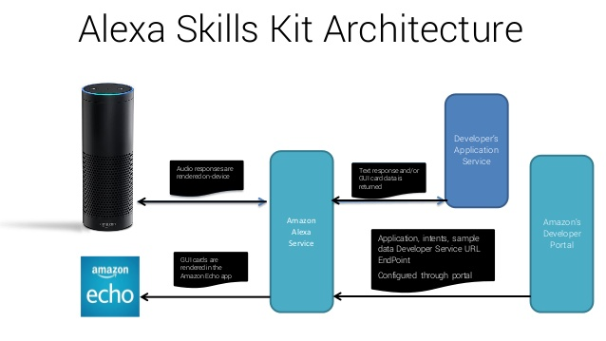
Notes:
We’re going to develop our own Alexa skills so that anybody from any department who is a stakeholder in this system can ask and find out the status or ask questions like How many Trials are there? What’s the average number of requests per day?

Slide 21
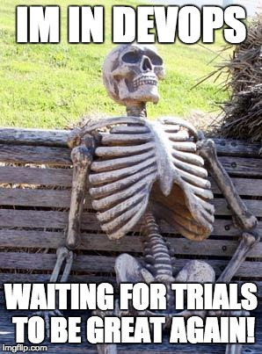
Notes:
DevOps are here to make Trials great again. No more manual steps, no more hacky scripts, no more emails to the executive team about failed Trials! Thank you all for your time, have a great day!

Slide 22
Twitter: @Python_Primer Skype: martin.whittington1 Github: github.com/SubatomicHero
presentations@orderofthebee.org

